Slide 1

Testing and Verification (CSC7056/CSC3056)
Aidan McGowan
Test management –
Incident reporting

Slide 2

Incidents
Since one of the objectives of testing is to find defects, the discrepancies between actual and expected outcomes need to be logged as incidents.
Incidents may be raised during :
  Development
  Review
  Testing
  Use of actual software

Slide 3
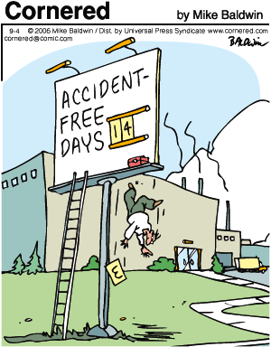
Incidents raised against ..
Code
On the working system
Documentation
  Requirements
  Test documents
  User information
  Help documentation

Slide 4

Incident – the process
Investigate
May turn out to be a defect.
Appropriate actions to dispose of incidents and defects shall be defined.

Slide 5

Recorded, tracked and analysed
Incidents are tracked from discovery and classification to correction and confirmation of the solution.
Organisations will normally have an incident management process and rules for classification.

Slide 6
Incident reports
Objectives
  Provide developers and other parties with feedback about the problem to enable identification, isolation and correction as necessary.
  Provide test leaders with a means of tracking the quality of the system under test and progress of the testing.
  Provide ideas for test improvement.

Slide 7
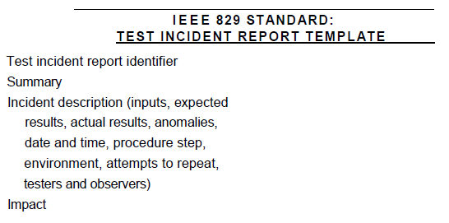

Slide 8
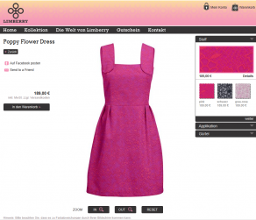

Exercise I
You are testing an e-commerce application for a designer clothing company and have discovered that when you click on a link to expand a product image another unrelated image is displayed. This happens for some but not all images.

Slide 9
Incident reporting ….
Test incident report identifier <Number>
Summary
Incident description –
Steps to reproduce
Suspected cause
Impact assessment

Slide 10
Test incident report identifier INC_0001
Summary
System shows an incorrect image when some thumbnails are clicked to expand
Incident description –
Steps to reproduce 1. Navigate to the products page 2. Select a product 3. Verify that incorrect image is displayed.
Suspected cause
It is likely that the naming of the larger images is inconsistent with that of the smaller images.
Impact assessment
Customers that wish to purchase an item are unlikely to do so if they are unable to see anything other than an thumbnail of the product. This may well lead to significant loss of profit. It also displays a lack of quality and attention to detail for the business which considering the expense of the products on sale is likely to damage company reputation.

Slide 11
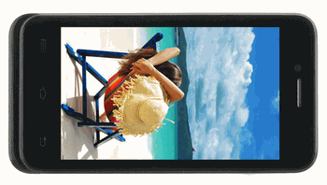

Exercise II
You provide technical support for a small Fuel Oil Distributor that has an Android app for customers to order oil. All customers that register for a news and updates feature are sent a Happy New Year text message from the company. The company have reported that not all customers queried said they received the message. The site uses a third party supplier to send the text messages.

Slide 12
Test incident report identifier INC_0002
Summary
Some customers have reported to have not received a scheduled courtesy text message.
Incident description –
Steps to reproduce ?
Suspected cause
It is possible that the customers have either entered their mobile numbers incorrectly or changed their numbers. There may also be a tariff limit on the number of text messages purchased by the oil company from the text messaging company.
Impact assessment
Limited. The company courtesy message is not a core part of the business and it may be that the client would prefer to accept the limited functionality rather than pay for the support or software update cost or if required to increase the text message tariff.

Slide 13
Exercise III
You are involved with the support of a web based application that enables users to order stationery items to small local businesses. The online system has been used for the past two years with some maintenance releases. The database used in the system was migrated from a previous one used for a desktop based ordering system (customers would telephone order). The company have grown quite considerably over the past year. The site owners have sent you the following email …
“A customer recently ordered 1000 units of Rexel Goliath Stapler (66) 02041 but only 100 units were recorded in the system. The user insists he ordered 1000. The customer was billed for 1000.”

Slide 14
Test incident report identifier INC_0003
Summary
A user has reported being able to order 1000 staplers but only 100 was received. The system has recorded the sale as 100. Customer was billed for 1000.
Incident description –
Steps to reproduce 1. Navigated to the products page 2. Selected the product Rexel Goliath Stapler (66) 02041 3. Select 1000. 4. Press order and confirm. 5. Verified that 100 was recorded in the DB. 6. Verified that the test paypal account was charged for 1000.
Suspected cause
The order appears to be processed correctly (in code) but when recorded in the database it is being reduced. It may be there is a limit set in the database on amount that may be ordered (from previous DB version). Possible incorrect range filter. This issue may have arisen due to the recent growth of the company which is why it may not have occurred before.
Impact assessment
Customers that receive only a portion of their order but are billed for the whole amount will lead to significant complaints and loss of repeat trade.

Slide 15
Exam questions

Slide 16
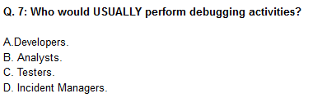
Notes:
A

Slide 17
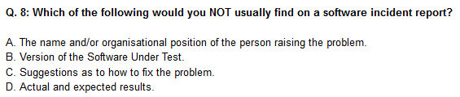
Notes:
C

Slide 18
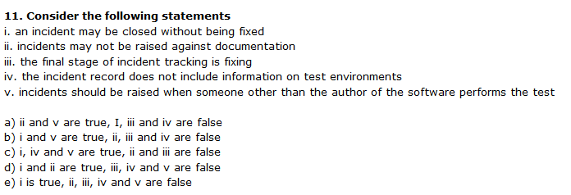
Notes:
B

